Slide 1

CLEAN WATER & SANITATION
PRESENTED BY
DATA MAVERICKS
GROUP 5

Slide 2
INTRODUCTION
The Sustainable Development Goals (SDGs) or Global Goals are a collection of 17 interlinked global goals designed to be a "shared blueprint for peace and prosperity for people and the planet, now and into the future".
The SDGs were set up in 2015 by the United Nations General Assembly (UN-GA) and are intended to be achieved by 2030. They emphasize the interconnected environmental, social and economic aspects of sustainable development, by putting sustainability at their center.

Slide 3
The 17 SDGs are:
No Poverty
Zero Hunger
Good Health And Well-being
Quality Education
Gender Equality
Clean Water And Sanitation
Affordable And Clean Energy
Decent Work And Economic Growth
Industry, Innovation And Infrastructure
Reduced Inequality
Sustainable Cities And Communities
Responsible Consumption And Production
Climate Action
Life Below Water
Life On Land
Peace, Justice, And Strong Institutions
Partnerships For The Goals

Slide 4

INTRODUCTION
For this presentation we would be talking about the sixth SDG:
CLEAN WATER AND SANITATION

Slide 5
UNSAFE WATER
Unsafe water is one of the world’s largest health and environmental problems – particularly for the poorest in the world.
Lack of access to safe water sources is a leading risk factor for infectious diseases, including cholera, diarrhea, dysentery, hepatitis A, typhoid and polio. It also exacerbates malnutrition, and in particular, childhood stunting. In the chart we see that it ranks as a very important risk factor for death globally.
According to the Global Burden of Disease study 1.2 million people died prematurely in 2017 as a result of unsafe water. To put this into context: this was three times the number of homicides in 2017; and equal to the number that died in road accidents globally.

Slide 6
UNSAFE WATER
Yearly, billions of people around the world are affected by issues caused by inadequate water supply, contaminated water and poor sanitation.
Millions have died from respiratory diseases and diarrheal diseases linked to unsafe water, inadequate sanitation and poor hygiene practices.
Access to clean water and sanitation plays a vital role in the general well being of humans.
Most of the sources of water in rural areas are terribly polluted due to poor sanitation and lack of waste treatment plants.
Overall level of global pollutants are having a negative effect on drinking water that is currently clean; as time goes on, this damage will be exacerbated.

Slide 7
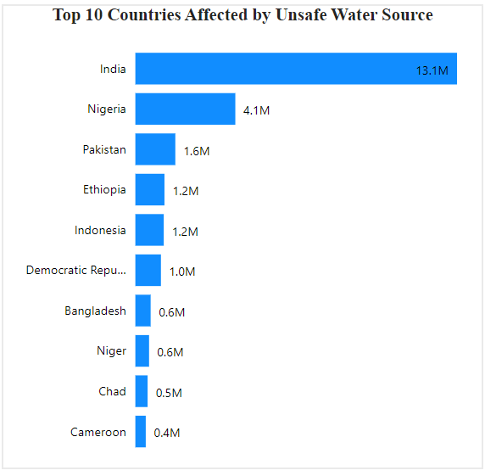
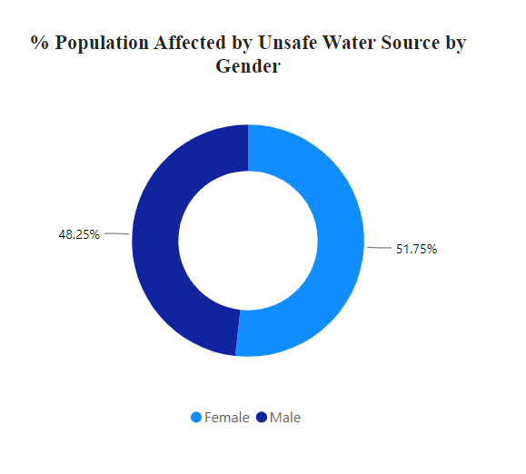
World Population Affected by Unsafe Water Consumption

Slide 8
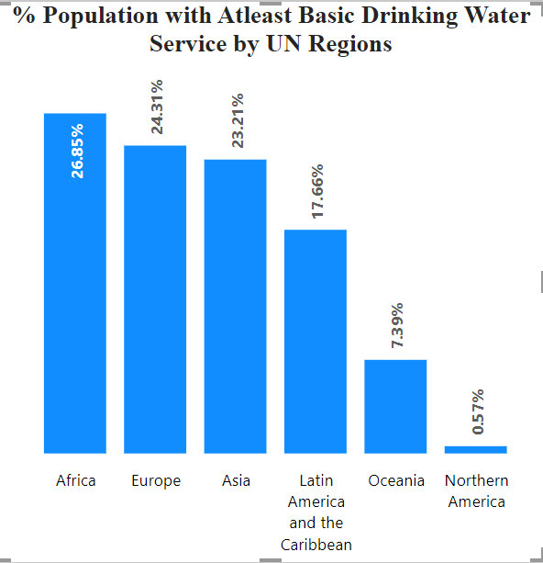
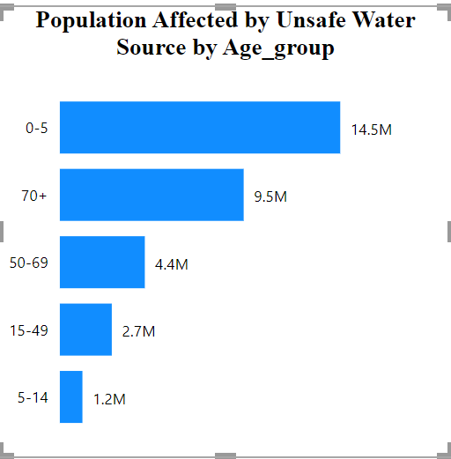
World Population Affected by Unsafe Water Consumption

Slide 9
UNSAFE SANITATION
Improper cleaning practices and disposal of wastes can contaminate the water bodies through external factors such as erosion, wind etc.
Unhygienic practices such as open defecation without proper handwashing with soap can lead to exposure to infectious diseases
Poor sanitation reduces human well-being, social and economic development due to impacts such as anxiety, risk of sexual assault, and lost opportunities for education and work.
Poor sanitation is linked to transmission of diarrheal diseases such as cholera and dysentery, as well as typhoid, intestinal worm infections and polio. It exacerbates stunting and contributes to the spread of antimicrobial resistance.

Slide 10
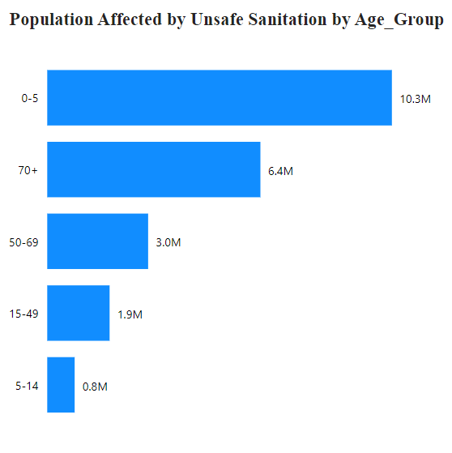
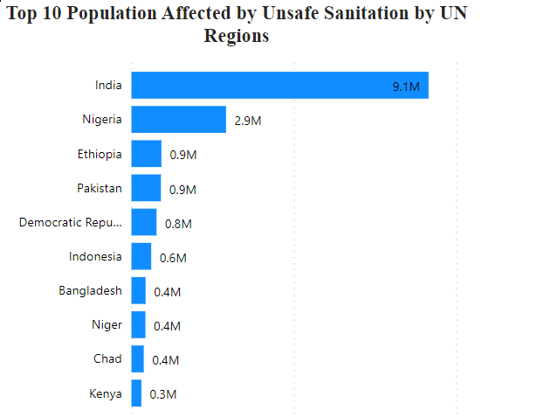
World Population Affected by Unsafe Sanitation

Slide 11
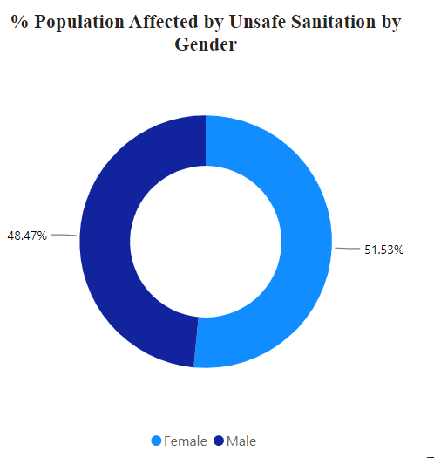
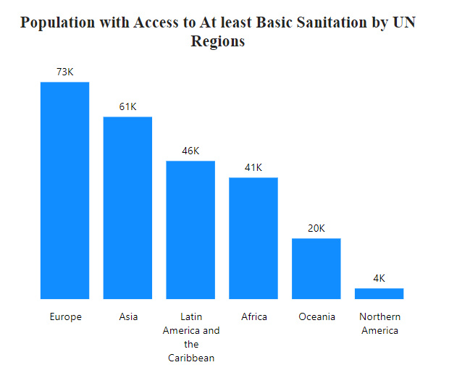
World Population Affected by Unsafe Sanitation

Slide 12
Causes of Water and Sanitation Issues
Climate Change
Water pollution
Mismanagement of water resources
Urbanization
Overpopulation
Lack of education

Slide 13
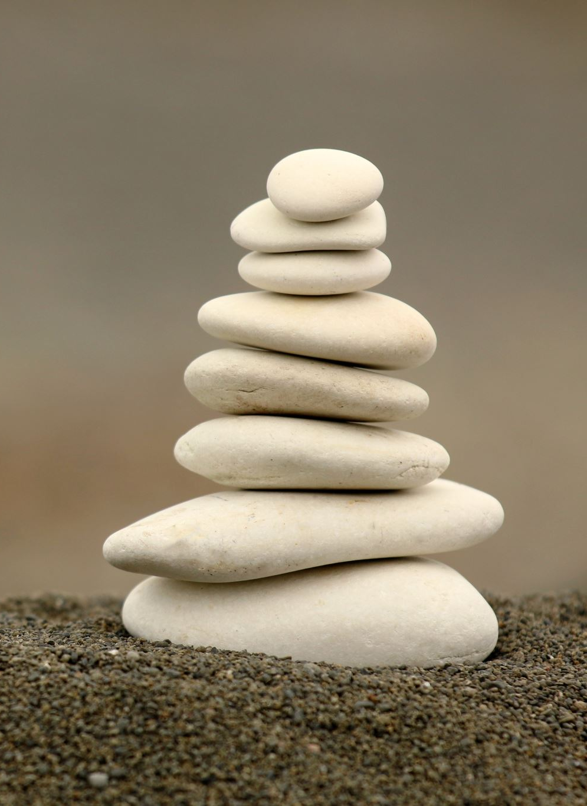
Solutions/Recommendations

Slide 14
To achieve the SDG 6 targets by 2030, everyone has a role to play.

Slide 15
Role to play as an Individual
Join a community that is focused on raising awareness about the need for clean water and sanitation and contributing to projects that will solve water and sanitation issues.
Get involved in legislation and policymaking.
Do your part to conserve water
Stay informed.

Slide 16
Role to play as an Organization and Governing Body
Education, training and encouraging local community participation in water and sanitation management.
Formulating policies and developing legal frameworks relating to equitable access to water and sanitation.
Funding and financing water and sanitation infrastructure systems.
Application of smart technologies supported by information technology to improve all aspects of water and sanitation management
Data acquisition and monitoring for evidence-based decision-making and to ensure accountability.

Slide 17
References
Hannah Ritchie and Max Roser (2021) - "Clean Water and Sanitation". Published online at OurWorldInData.org. Retrieved from: 'https://ourworldindata.org/clean-water-sanitation' [Online Resource]
Global Burden of Disease Collaborative Network. Global Burden of Disease Study 2019 (GBD 2019) Burden by Risk 1990-2019. Seattle, United States of America: Institute for Health Metrics and Evaluation (IHME), 2020
What causes lack of clean water (2021). Retrieved from Oasense: https://www.oasense.com/post/what-causes-a-lack-of-clean-water
Clean Water and Sanitation Solutions: How To Help Nationally and Internationally. (n.d.). Retrieved from Healing Waters International: https://healingwaters.org/how-to-help-clean-water-and-sanitation-nationally-and-internationally/
Sustainable Development Goal 6. Synthesis Report on Water and Sanitation. (2018). Retrieved from https://sustainabledevelopment.un.org/content/documents/19901SDG6_SR2018_web_3.pdf

Slide 18
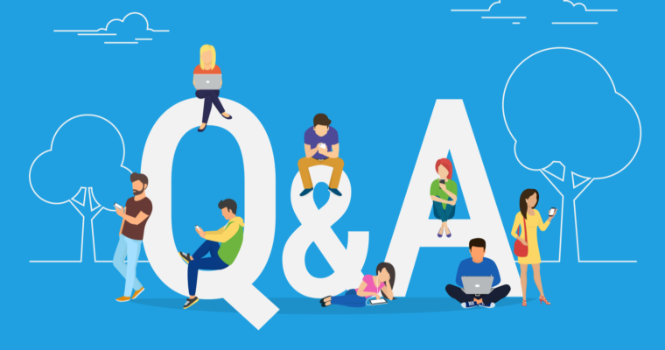

Slide 19
